Slide 1
Shapes around us

Slide 2
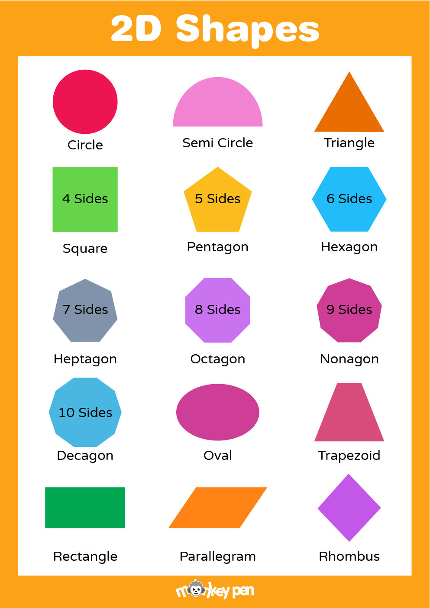

Slide 3
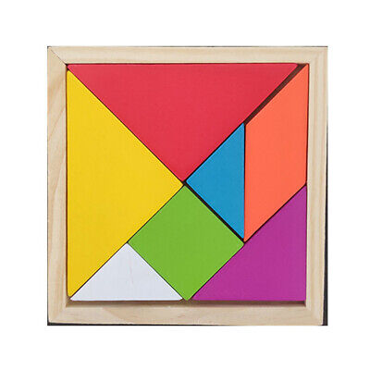
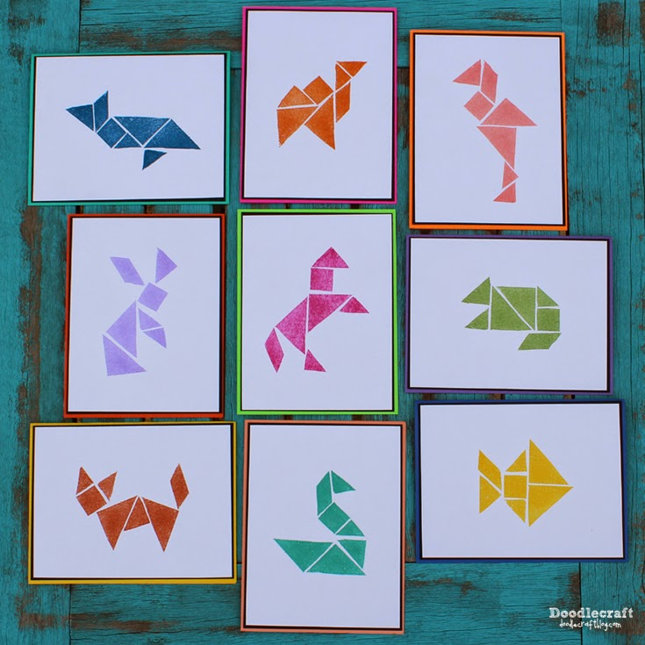
Tangram- a Chinese geometrical puzzle consisting of a square cut into seven pieces which can be arranged to make various other shapes.
CONTENT SLIDE

Slide 4
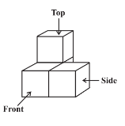
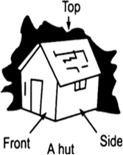
Types of views
CONTENT SLIDE

Slide 5
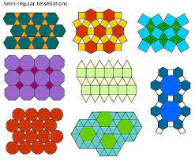
Tessellation
--an arrangement of shapes closely fitted together, especially of polygons in a repeated pattern without gaps or overlapping.
QUESTIONS RELATED TO ABOVE SLIDES

Slide 6
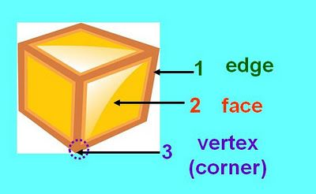
CONTENT SLIDE

Slide 7
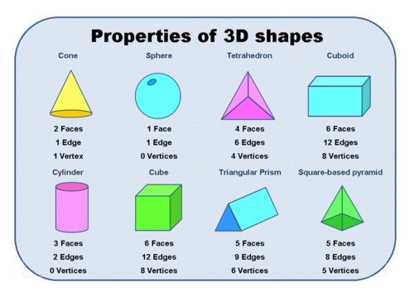
CONTENT SLIDE

Slide 8
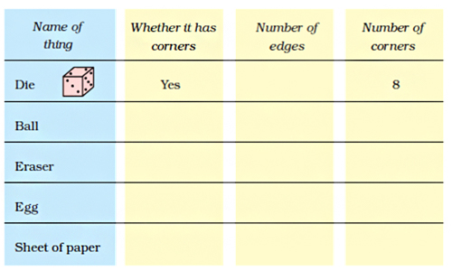
CONTENT SLIDE

Slide 10
Thank you

